Slide 1


CS 235: User Interface Design April 16 Class Meeting
Department of Computer Science San Jose State University Spring 2015 Instructor: Ron Mak
www.cs.sjsu.edu/~mak

Slide 2
Mobile Application Demo Schedule
Tuesday, April 21
Unknown, UXability, X Factor
Thursday, April 23
Innovative Designers, Team Four, Thundercats

Slide 3
Mobile Application Prototype Reports
A short report:
What is your application.
What UI design patterns did you use and why.
Describe up to 5 patterns.
Screen shots that illustrate your design patterns.
Your PowerPoint slides, if any.
Your prototype code, if runnable by anyone.
Include installation and how to run instructions.
Due one week after your demo.

Slide 4
Overcoming the Limits of Memory
Long term memory ≈ computer’s hard drive
Working memory ≈ RAM
Different memory storage for different types of information
Verbal, visual, etc.
Visual memory can handle only about three chunks (units of information) at a time.

Slide 5
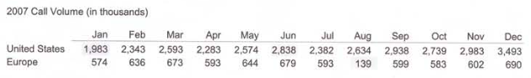
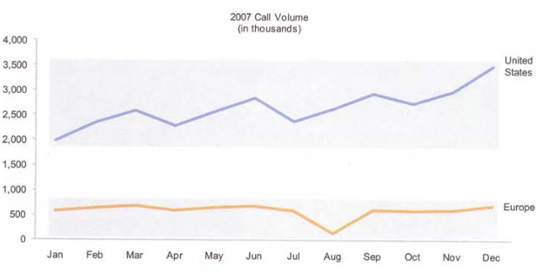
Overcoming the Limits of Memory, cont’d
Consider the following table.
Perhaps you can remember three of the numbers.
The following line graph stores all of the numbers in a single chunk.
Now You See It
by Stephen Few
Analytics Press, 2009

Slide 6
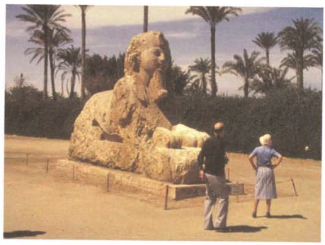
Overcoming the Limits of Memory, cont’d
The problem we had with these photos …
Now You See It
by Stephen Few
Analytics Press, 2009

Slide 7
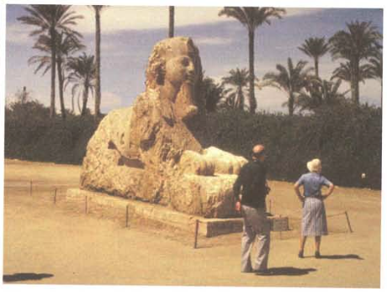
Overcoming the Limits of Memory, cont’d
… is that they were split over two screens.
Now You See It
by Stephen Few
Analytics Press, 2009

Slide 8
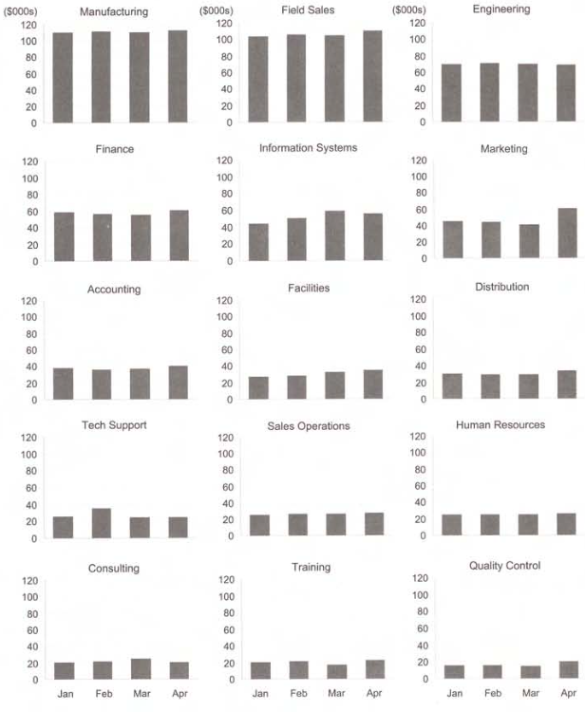
Overcoming the Limits of Memory, cont’d
Create a dashboard that puts all the important information on a single screen.
Now You See It
by Stephen Few
Analytics Press, 2009

Slide 9
Building Blocks of Information Visualization
Visual perception
Visual objects
Visual properties
Quantitative reasoning
Quantitative relationships
Quantitative comparisons
Information visualization
Visual patterns, trends, and exceptions
Understanding ➔ good decisions

Slide 10
Analytical Interactions with data
Comparing
Sorting
Adding variables
Filtering
Highlighting
Aggregating
Re-expressing
Re-visualizing
Zooming and panning
Re-scaling
Accessing details on demand
Annotating
Bookmarking

Slide 11
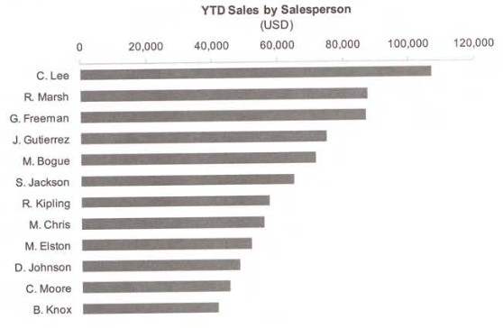
Comparing
Now You See It
by Stephen Few
Analytics Press, 2009

Slide 12
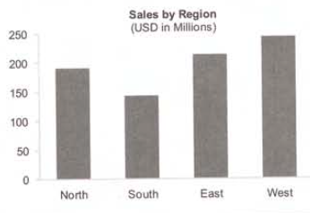
Typical Magnitude Comparisons
Nominal
Values that have no particular order.
Now You See It
by Stephen Few
Analytics Press, 2009

Slide 13
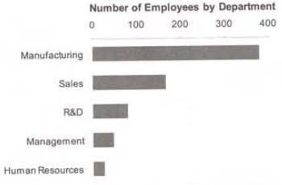
Typical Magnitude Comparisons, cont’d
Ranking
Compare values that are arranged by magnitude.
Now You See It
by Stephen Few
Analytics Press, 2009

Slide 14
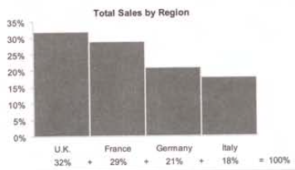
Typical Magnitude Comparisons, cont’d
Part-to-whole
Compare values that are parts of a whole.
Now You See It
by Stephen Few
Analytics Press, 2009

Slide 15
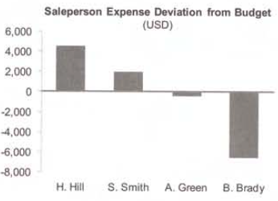
Typical Magnitude Comparisons, cont’d
Deviation
Compare differences between two sets of values.
Now You See It
by Stephen Few
Analytics Press, 2009

Slide 16
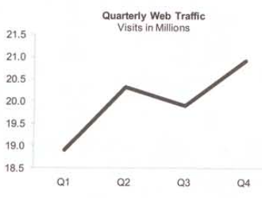
Typical Magnitude Comparisons, cont’d
Time series
Show how values changed over time.
Now You See It
by Stephen Few
Analytics Press, 2009

Slide 17
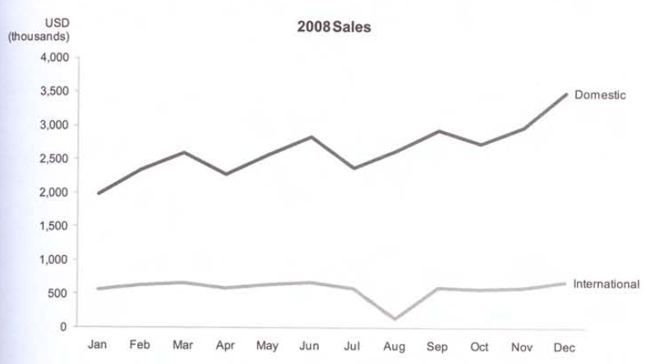
Typical Magnitude Comparisons, cont’d
Time series, cont’d
Now You See It
by Stephen Few
Analytics Press, 2009

Slide 18
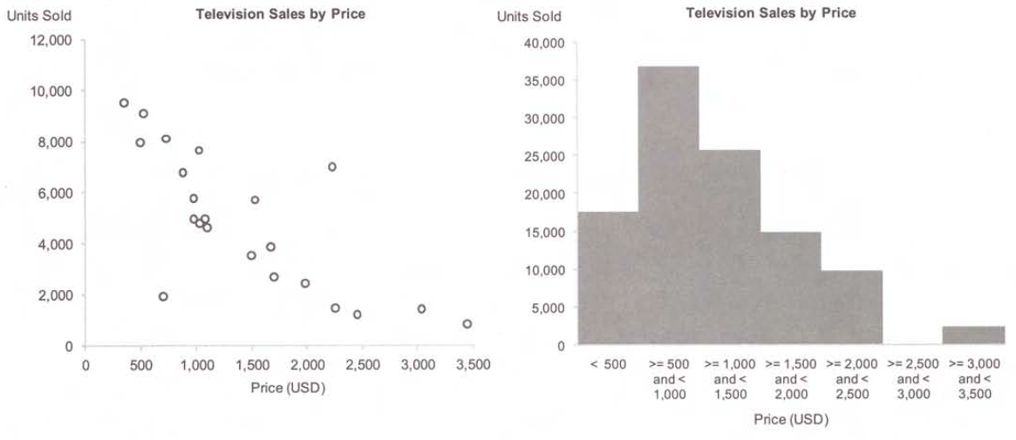
Typical Magnitude Comparisons, cont’d
Scatter plot vs. bar chart
Now You See It
by Stephen Few
Analytics Press, 2009

Slide 19
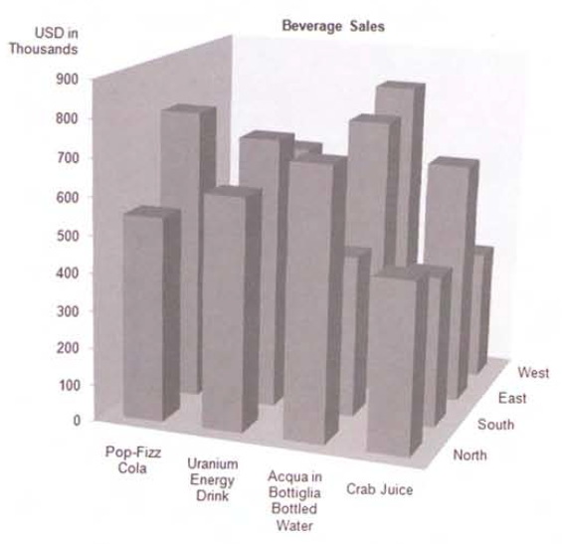
Avoid 3-D Graphs!
Some bars obscure others.
Now You See It
by Stephen Few
Analytics Press, 2009

Slide 20
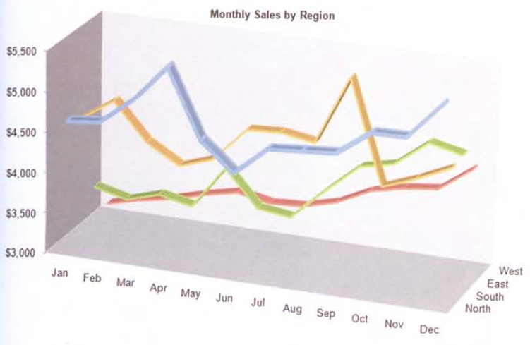
Avoid 3-D Graphs! cont’d
Which line represents the East region?
Now You See It
by Stephen Few
Analytics Press, 2009

Slide 21
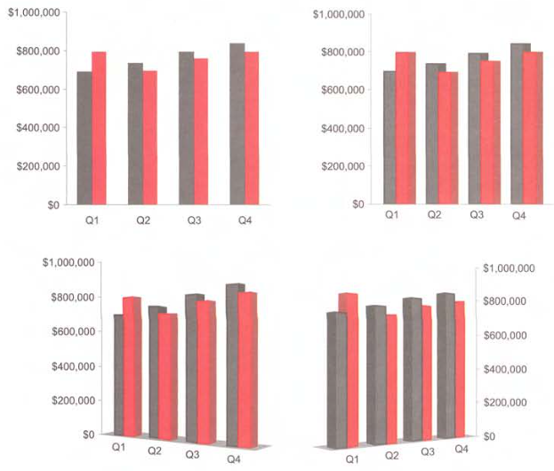
Avoid 3-D Graphs! cont’d
Which is easiest to read?
Now You See It
by Stephen Few
Analytics Press, 2009

Slide 22
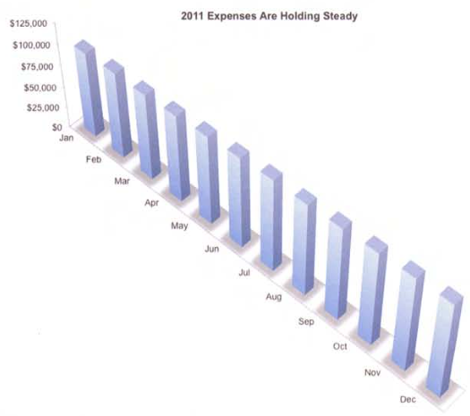
Avoid 3-D Graphs! cont’d
What are we hiding?
Expenses rose from
$100,000 to $121,000.
Show Me the Numbers
by Stephen Few
Analytics Press, 2012

Slide 23
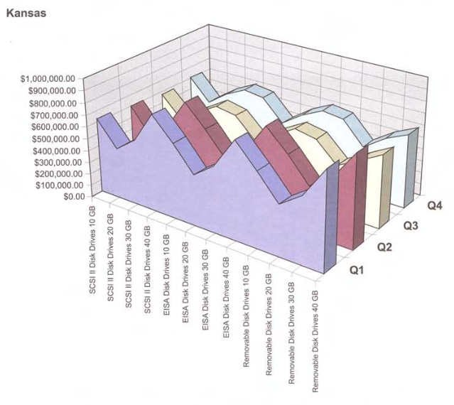
Avoid 3-D Graphs! cont’d
Show Me the Numbers
by Stephen Few
Analytics Press, 2012

Slide 24
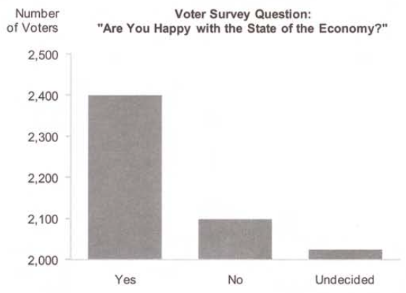
Relative Heights in Bar Charts
Are the “Yes” responses 4X the “No” responses?
Bar charts
should always
include 0.
Now You See It
by Stephen Few
Analytics Press, 2009

Slide 25
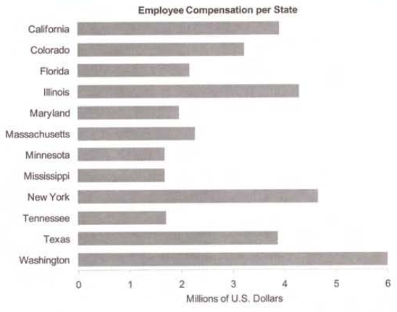
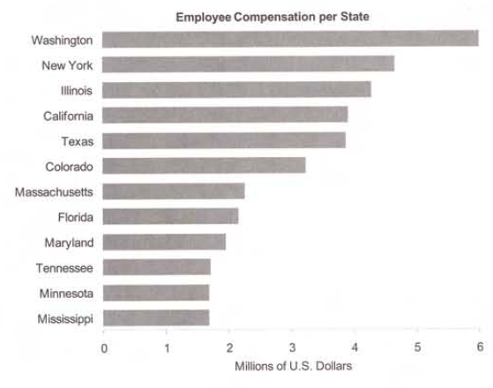
Sorting
Sorted graphs provide more information.
Now You See It
by Stephen Few
Analytics Press, 2009

Slide 26
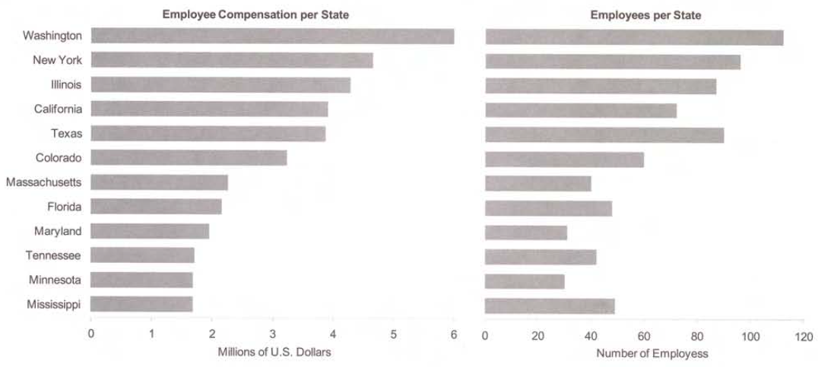
Sorting, cont’d
Sorting + correlation
Now You See It
by Stephen Few
Analytics Press, 2009

Slide 27
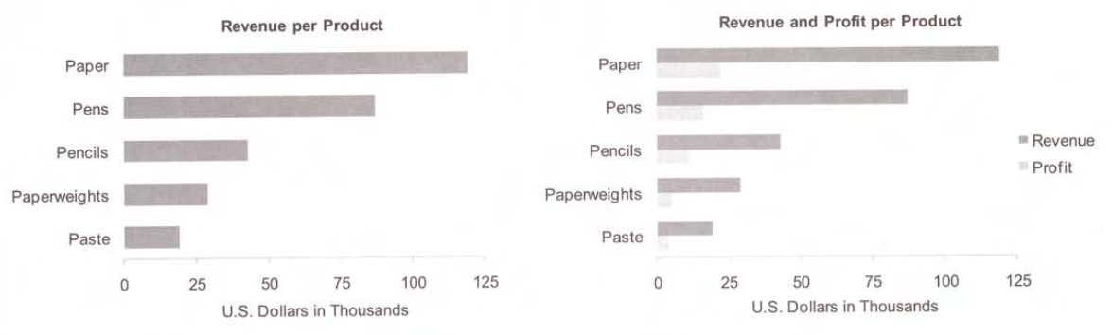
Adding Variables
We may not always know in advance which variables we should analyze.
Now You See It
by Stephen Few
Analytics Press, 2009

Slide 28
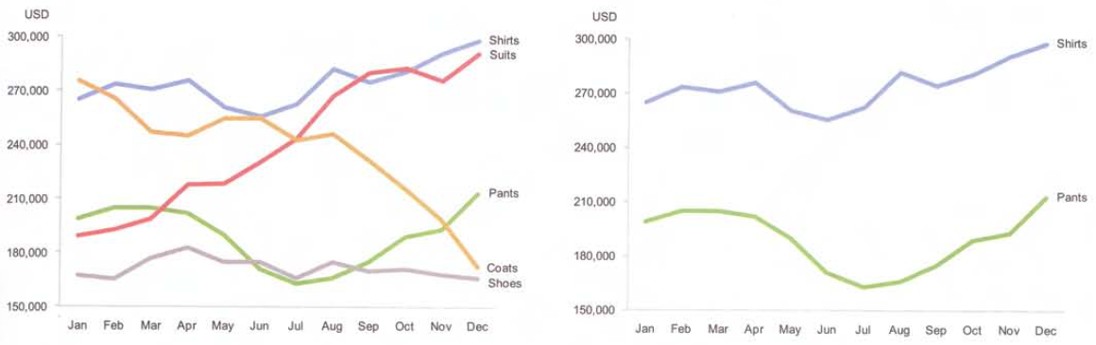
Filtering
Reduce the data that we’re analyzing to a subset.
Now You See It
by Stephen Few
Analytics Press, 2009

Slide 29
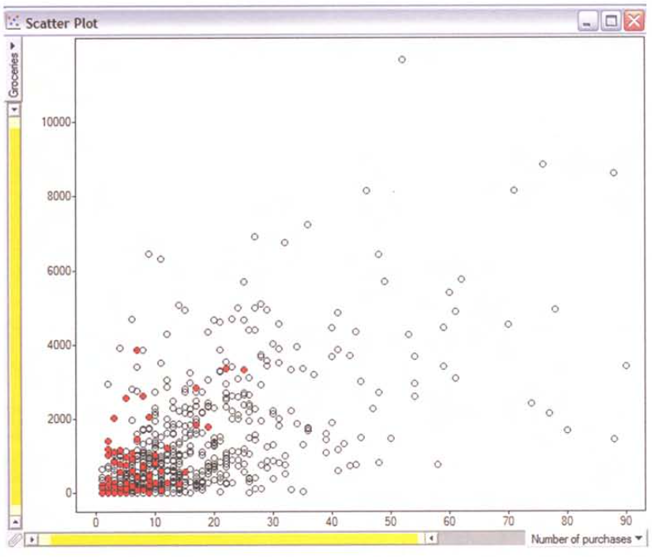
Highlighting
Instead of filtering, make certain data stand out.
Now You See It
by Stephen Few
Analytics Press, 2009

Slide 30
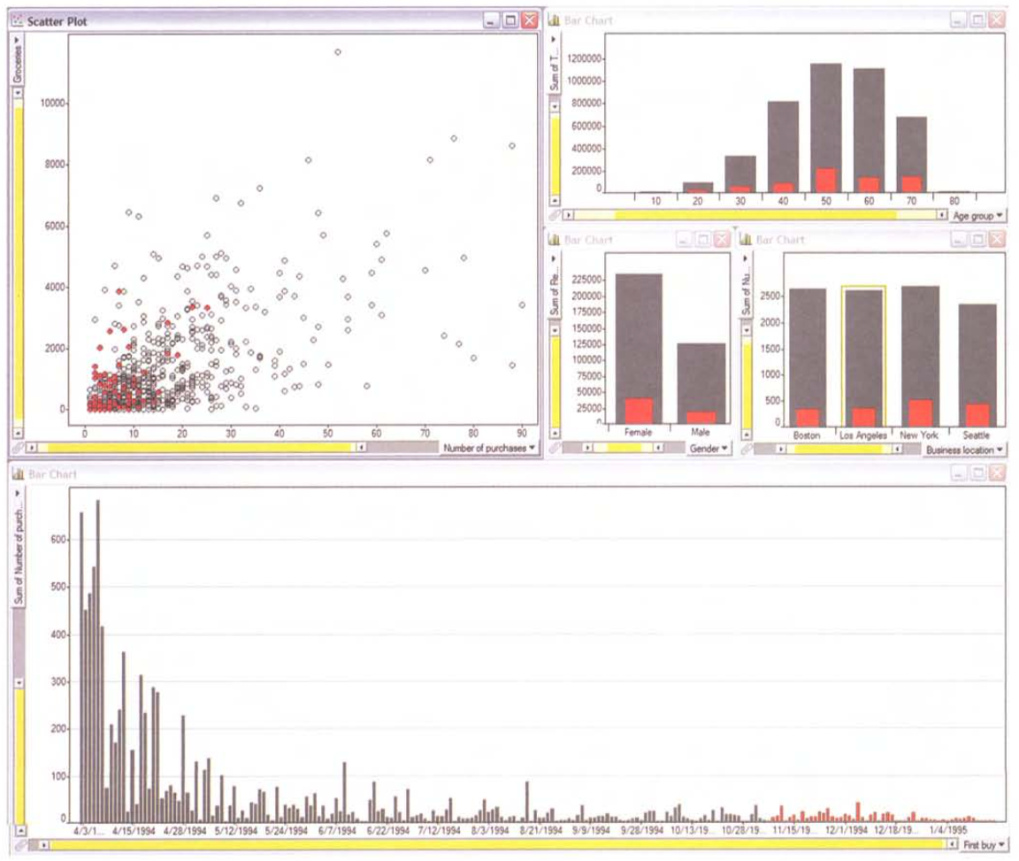
Highlighting, cont’d
Brushing highlights the same subset of data across multiple graphs.
Now You See It
by Stephen Few
Analytics Press, 2009

Slide 31
Aggregating
With hierarchical data, we can aggregate at multiple levels.
Examples:
Aggregate daily data ➔ weekly totals
Aggregate store data ➔ regional totals
Aggregating / de-aggregating are associated with drill up / drill down operations with the data.

Slide 32
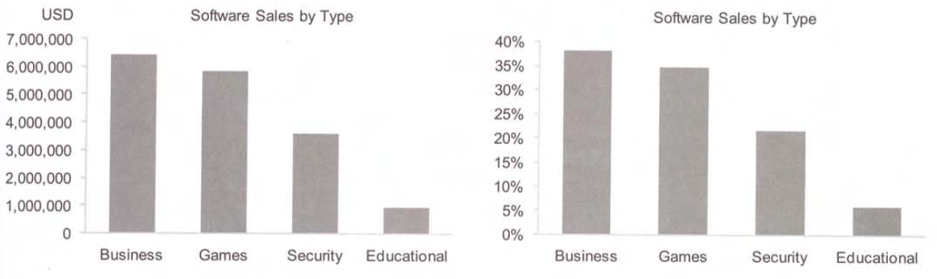
Re-Expressing
Change the graph parameters in order to gain new insights.
Now You See It
by Stephen Few
Analytics Press, 2009

Slide 33
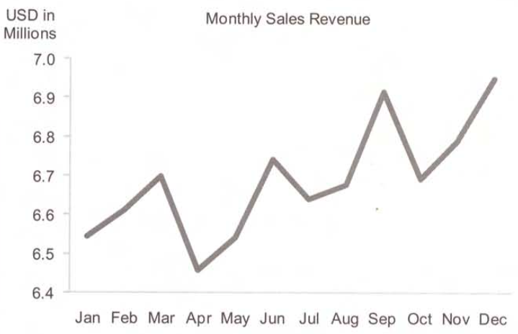
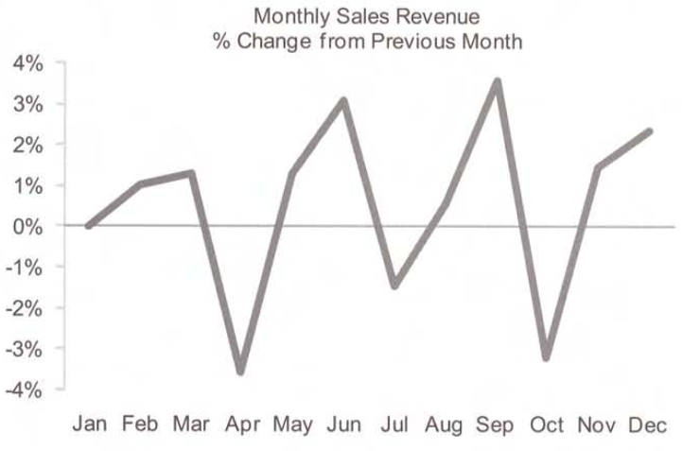
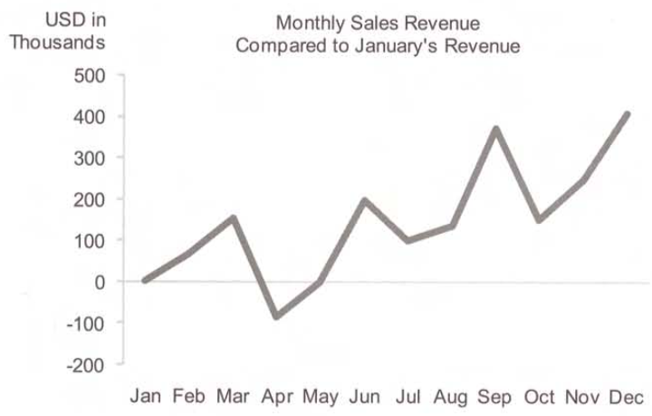
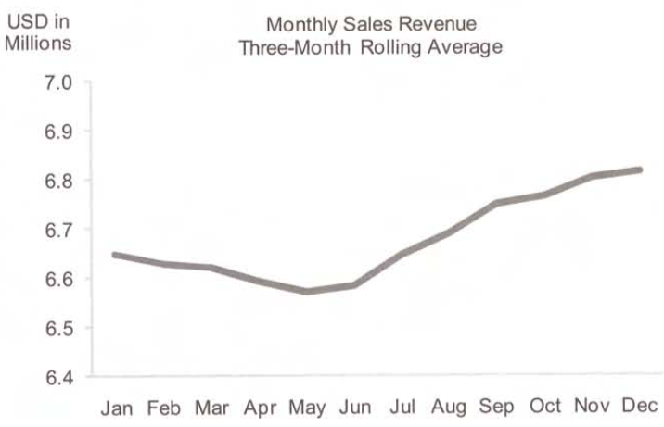
Re-Expressing, cont’d
Now You See It
by Stephen Few
Analytics Press, 2009

Slide 34
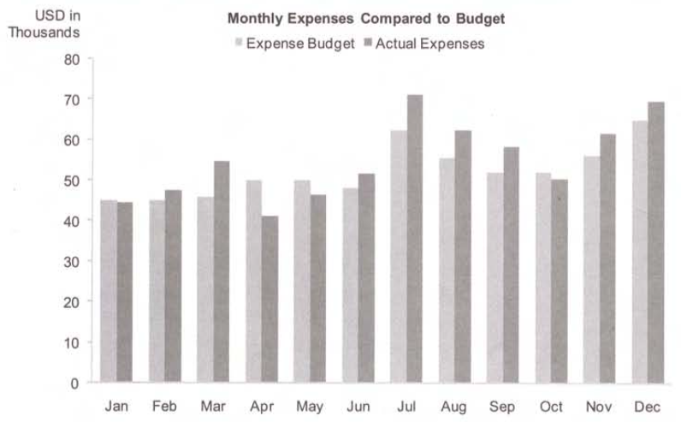
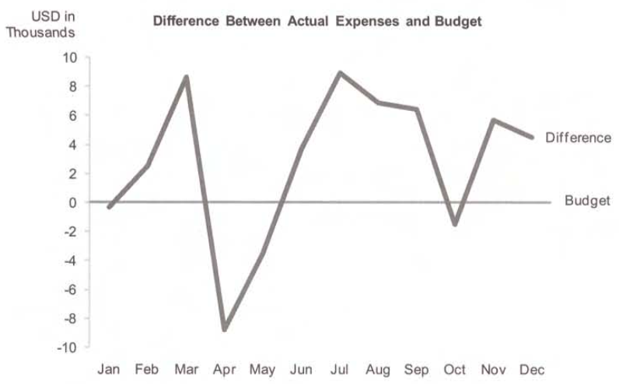
Re-Visualizing
Change the type of graph in order to gain new insights.
Now You See It
by Stephen Few
Analytics Press, 2009

Slide 35
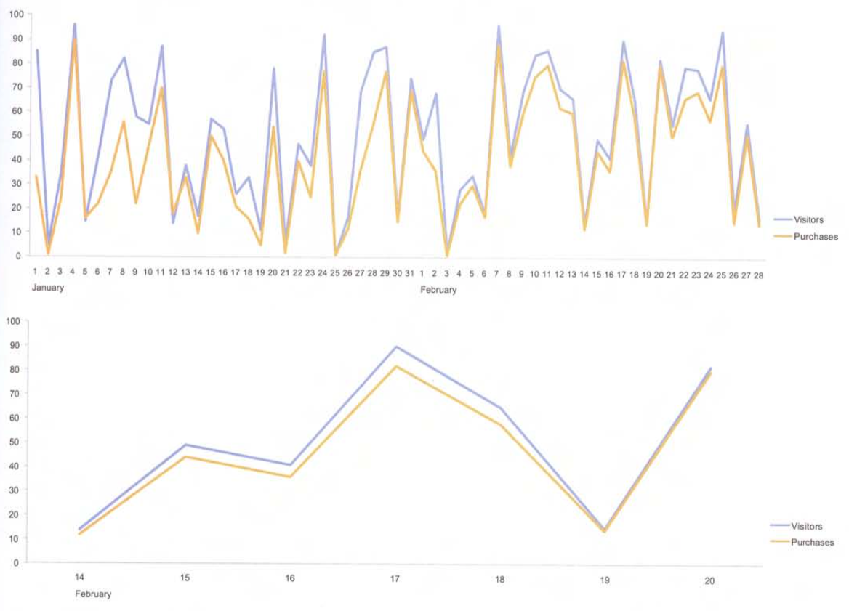
Zooming and Panning
Zoom in on an area of interest in a graph.
Now You See It
by Stephen Few
Analytics Press, 2009

Slide 36
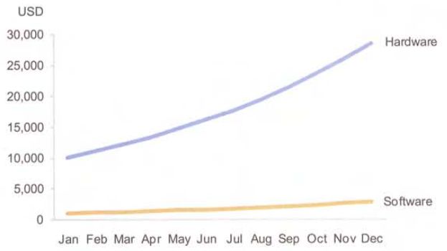
Re-Scaling
Are hardware sales or software sales increasing at a faster rate?
Both are
increasing
at the same
10% rate.
How can this be made
clearer?
Now You See It
by Stephen Few
Analytics Press, 2009

Slide 37
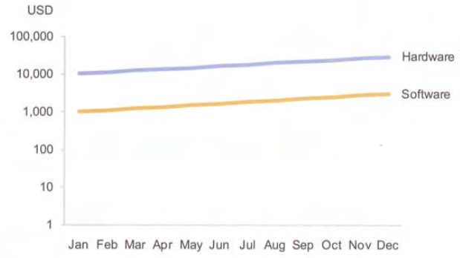
Re-Scaling, cont’d
Use a logarithmic scale.
Now You See It
by Stephen Few
Analytics Press, 2009

Slide 38
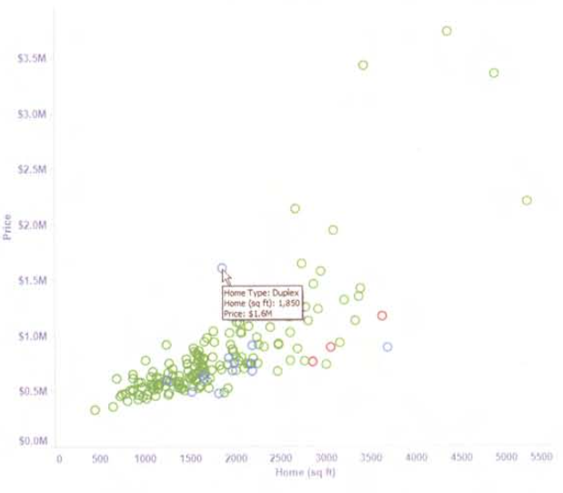
Accessing Details on Demand
Details pop up when the mouse hovers.
Now You See It
by Stephen Few
Analytics Press, 2009

Slide 39
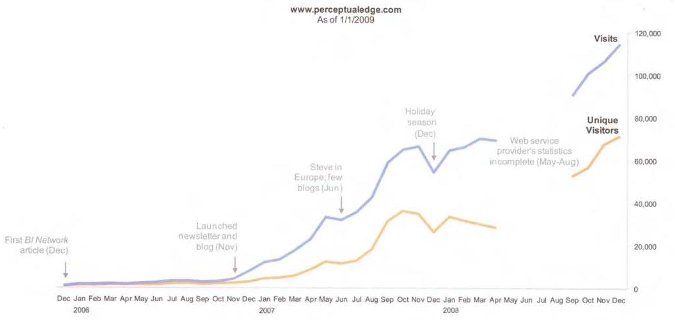
Annotating
Helpful notes are displayed on a graph.
Now You See It
by Stephen Few
Analytics Press, 2009

Slide 40
Bookmarking
Be able to return to a previous view of the data.
Save a snapshot of a view.
“Back” and “undo” capabilities.

Slide 41
Shneiderman’s Mantra
“Overview first, zoom and filter, then details-on-demand.”
Get an overview of an entire scene and then home in on whatever appears abnormal.

Slide 42
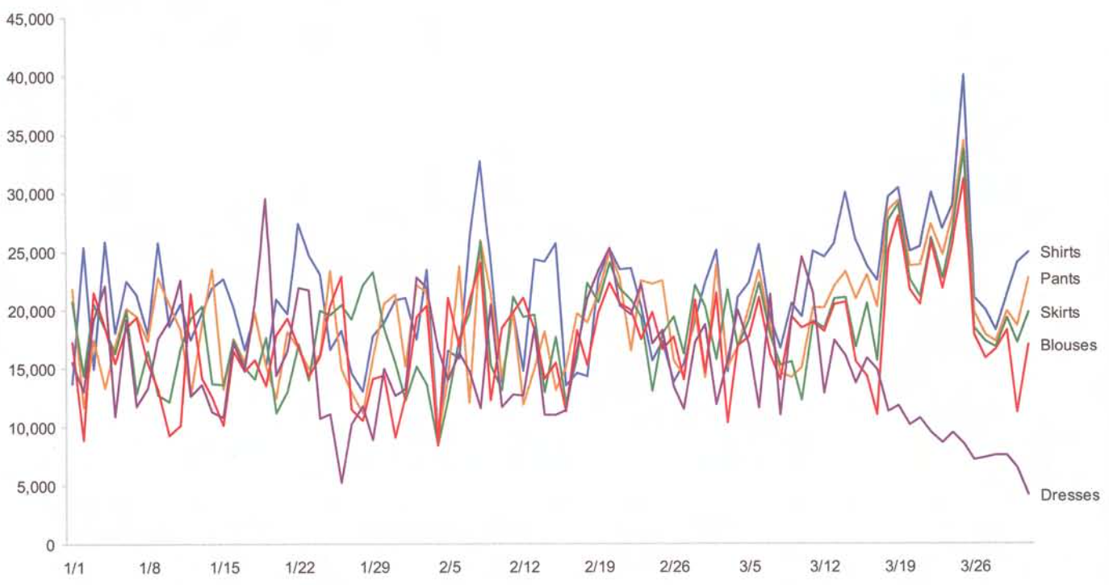
Shneiderman’s Mantra, cont’d
First, the overview:
Now You See It
by Stephen Few
Analytics Press, 2009

Slide 43
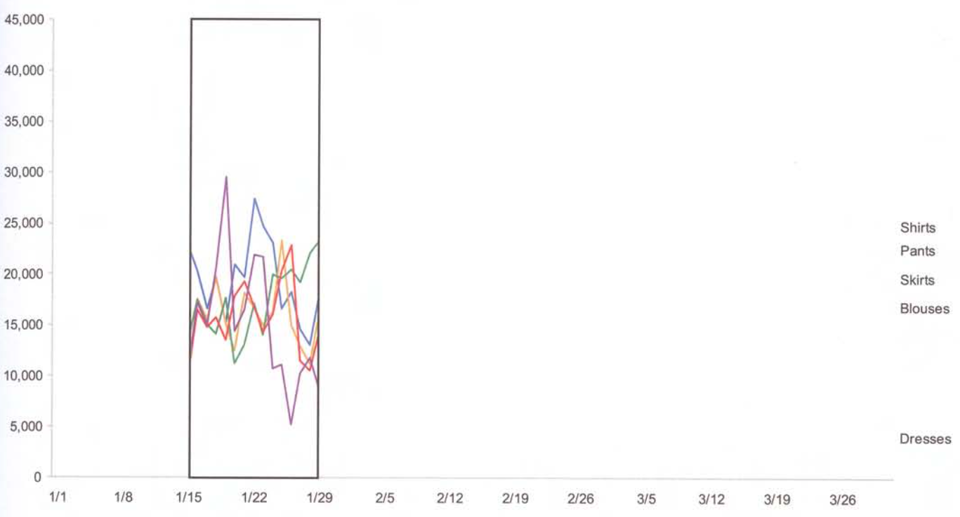
Shneiderman’s Mantra, cont’d
Zoom in on a particular point of interest.
Now You See It
by Stephen Few
Analytics Press, 2009

Slide 44
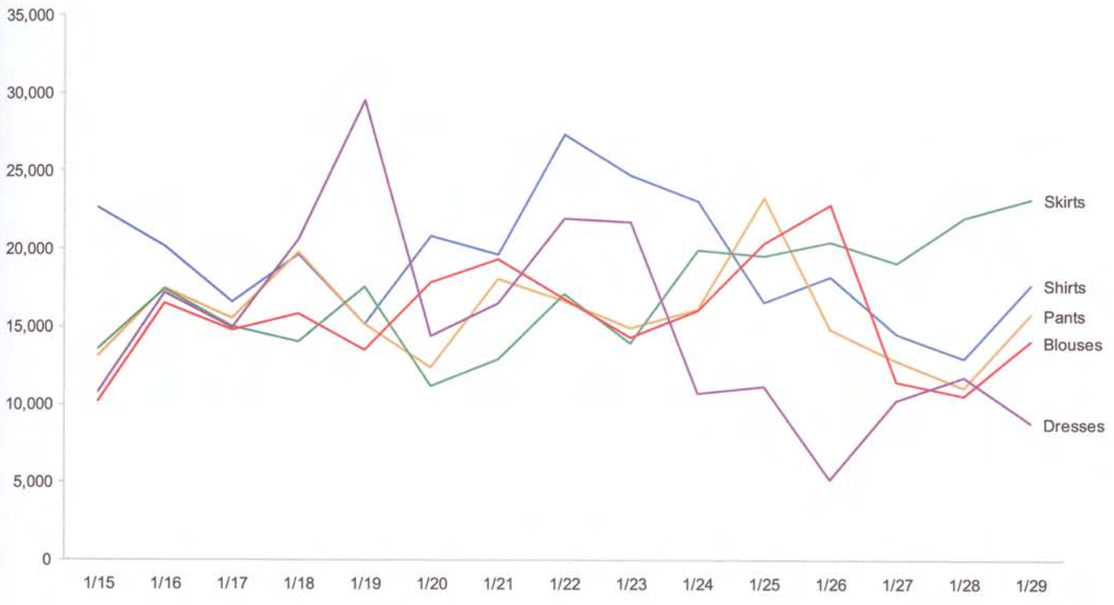
Shneiderman’s Mantra, cont’d
Examine it more closely and in greater detail.
Now You See It
by Stephen Few
Analytics Press, 2009

Slide 45
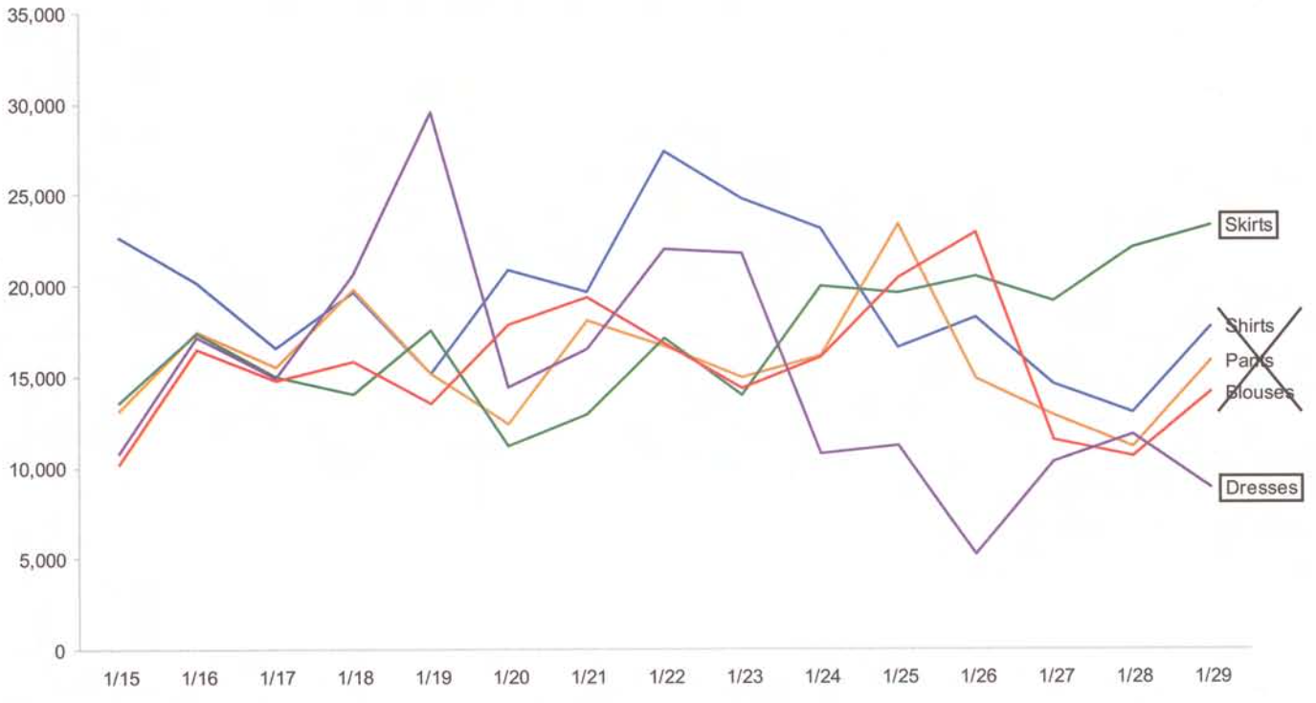
Shneiderman’s Mantra, cont’d
Filter out what’s extraneous to our investigation.
Now You See It
by Stephen Few
Analytics Press, 2009

Slide 46
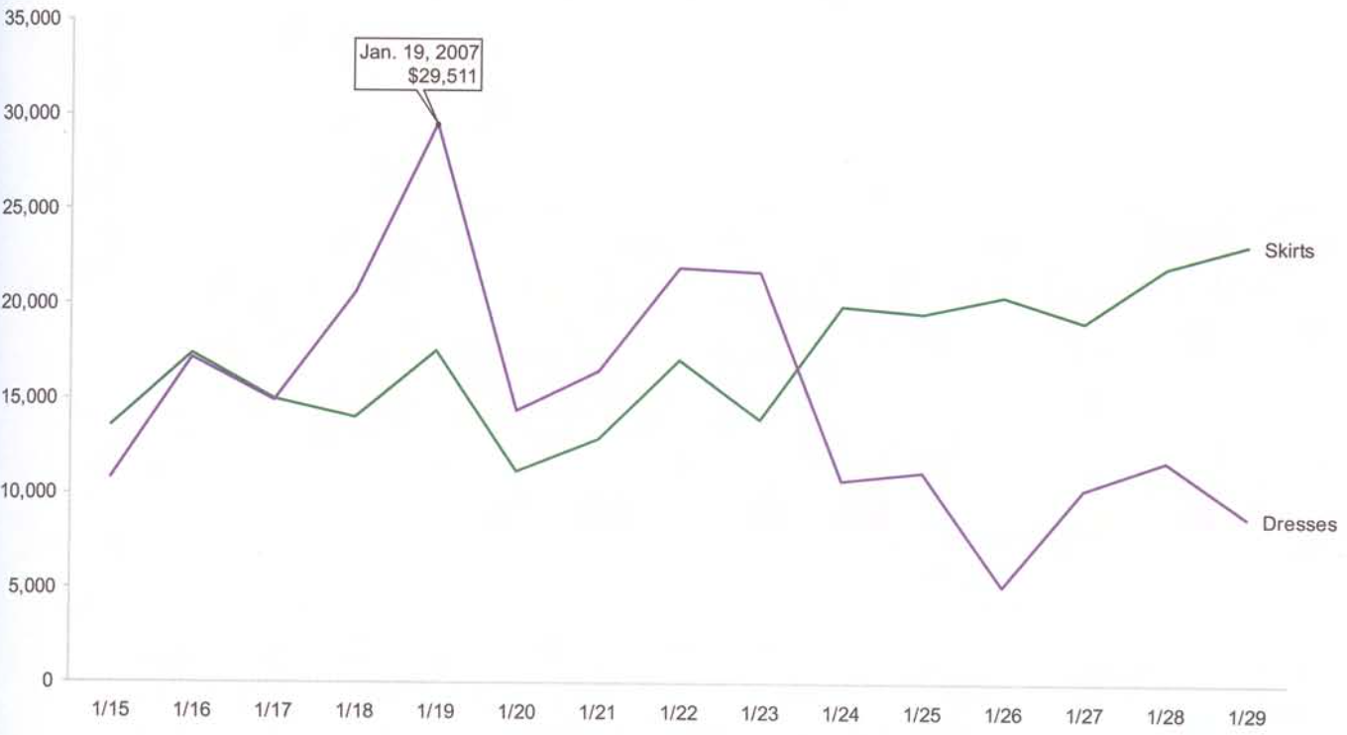
Shneiderman’s Mantra, cont’d
Home in to get greater detail.
Now You See It
by Stephen Few
Analytics Press, 2009

Slide 47
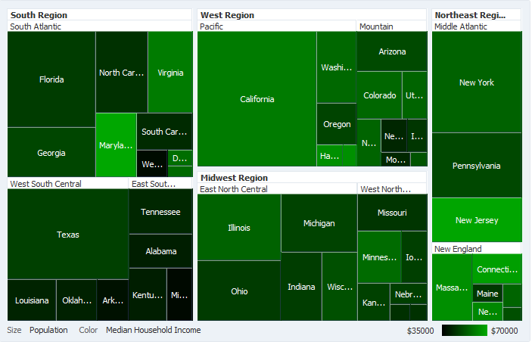
Tree Maps for Hierarchical Data
Nested rectangles show containment.
https://docs.oracle.com/middleware/1212/adf/ADFUI/img/dvt_intro_treemap.png

